Slide 1
The CPA’s Guide to Ethical Behavior
By Jolene A. Lampton
Ph.D., MBA, BSE, CPA, CGMA & CFE
January, 2022

Slide 2
The CPA’s Guide to Ethical Behavior
Jolene A. Lampton, Ph.D., MBA, BSE, CPA, CGMA and CFE
CPA since 1982; CFE in 2015
Licensed in Texas and Missouri
apexcpe course since 2007
Full-time professor teaching accounting at Park University
Ethics is a research area for Dr. Lampton; Dr. Lampton completed the 2011 Bentley University Global Business Ethics Symposium in Marseille, France and other scholarly activities in ethics

Slide 3
The CPA’s Guide to Ethical Behavior
E Everywhere
T All the Time
H Be Honest
I Act with Integrity
C Have Compassion
S For What is at Stake is
                Your reputation,
                Your Self-esteem,
                Your Inner Peace.

Slide 4
The CPA’s Guide to Ethical Behavior
Ethics----is based on the Golden Rule;
Comes from the ancient Greeks – Socrates, Plato and Aristotle;
Philosophers include:
  Immanuel Kant (1724-1804)
      Moral acts undertaken from “a sense of duty dictated by reason”
      Lawrence Kohlberg (1927-1987)
      Stages of Moral Development – 6 stages
      CPA’s typically operate at Levels 3 or4 [levels where being influenced is common]

Slide 5
The CPA’s Guide to Ethical Behavior
Ethics is a matter of ethos or participation in a community . . . a way of life;
To be moral means doing things right;
It pays to pursue a wider role on environmental and social issues;
Core tenets on which a company is built;
Core tenets emulate from values;
Companies with values are good companies to work for!

Slide 6
The CPA’s Guide to Ethical Behavior
Our values do have voices---that we can use;
  · Values are what we really want is strive for: to be able to feel like we have voiced and acted on our values is gratifying;
Need to focus our energy on finding ways to be consistent with our values.

Slide 7
The CPA’s Guide to Ethical Behavior
Business practitioners can voice and implement their values . . . in the face of countervailing pressures in the workplace
    Without whistleblowing;
    Some people do voice and act on their values [and do so effectively];
    Diminishing the impact of self-justifying rationalizations for actions;
    Acknowledge values and ethical choice

Slide 8
The CPA’s Guide to Ethical Behavior
Ethical Approaches
    Code of Ethics or Statement of Values
    Cluster of objectives . . . core tenets on which the company is built
    Mission Statements
    Tone from the Top
    Ways to use ethical reasoning
        Let values have voices
        Group/team approach to talk through dilemmas
        Message from the “Top” of the organization
        Leadership by example – the best way!

Slide 9
The CPA’s Guide to Ethical Behavior
Vital to gain an understanding of the culture of the organization
Culture must support and nourish ethics
CEO should continuously demonstrate his/her expectations
Serves as a constant reminder to employees
CEO must require management team to expect clear numbers, good operations, clear measurements
Tips—when known—must be dealt with fairly
When the above practices are the norm, the culture stands a good chance of becoming “an ethical culture.”

Slide 10
The CPA’s Guide to Ethical Behavior
An ethical culture
    Requires constant behaviors
    Always performed
    Even under fire
    To become habit for the organization;
    . . . demands that the correct message be sent or it will be severely impaired.

Slide 11
The CPA’s Guide to Ethical Behavior
To ensure an Ethical Culture
    Create forums of ethical issues and dilemmas that face employees
    Articulate steps to resolve matters
    Role play training situations to practice the right thing
    Highlight methods to be taken to resolve situations
    If corrective action is taken no matter what it takes, employees get the message!
    Culture is set in intricate and critical ways!
    Obviously, the culture can be severely impaired if the wrong message is sent!

Slide 12
The CPA’s Guide to Ethical Behavior
Ethical culture requires ethical reasoning coming through in various ways
    CEO must lead by example
    CEO and executive team need to display the expectation for ethical standards continuously
    Ethical practices need to be reinforced in training and compliance programs
    Steps for ethical reasoning should be documented in P&P manuals
    Ethics needs to be the rule for the organization.

Slide 13
The CPA’s Guide to Ethical Behavior
"Ethics isn’t just about tone at the top. It’s about tone throughout the organization."
Jeff Thomson, CMA, CAE
IMA President

Slide 14
The CPA’s Guide to Ethical Behavior
Best Practices for Making an Ethics Code Effective (Barman and White, 2014)
  Root the code in core values such as trust and integrity.
  Give a copy to all staff.
  Provide a way to report breaches in a confidential manner.
  Include ethical issues in corporate training programs
  Set up a board committee to monitor the effectiveness of the code.
  Report on the code’s use in an annual report.
  Make conformity to the code part of a contract of employment.
  Make the code available in the language of staff located overseas.
  Make copies of the code available to business partners including suppliers.
  Make a named individual responsible for code implementation.
  Review the code in light of changing business challenges.
  Make sure senior staff “walk the talk.”

Slide 15
The CPA’s Guide to Ethical Behavior
Formulating an ethical climate is good business!
To maintain public confidence, follow good business practices;
CPAs need to expect the organization they serve to work for the public interest!

Slide 16
The CPA’s Guide to Ethical Behavior
Expectation from mid-level managers is
ETHICAL LEADERSHIP

Slide 17
The CPA’s Guide to Ethical Behavior
Public Accountancy Act directs the Texas State Board of Public Accountancy to develop rules of professional conduct to establish and maintain high standards of competence and integrity;
Follow the Rules of Professional Conduct from the TSBPA

Slide 18
The CPA’s Guide to Ethical Behavior
Rules of Professional Conduct of Texas Administrative Code
EXAMINING BOARDS
http://texreg.sos.state.tx.us/public/readtac$ext.ViewTAC?tac_view=3&ti=22&pt=22
TEXAS STATE BOARD OF PUBLIC ACCOUNTANCY
RULES OF PROFESSIONAL CONDUCT
http://texreg.sos.state.tx.us/public/readtac$ext.ViewTAC?tac_view=4&ti=22&pt=22&ch=501
Subchapters A through E

Slide 19
The CPA’s Guide to Ethical Behavior
http://texreg.sos.state.tx.us/public/readtac$ext.ViewTAC?tac_view=3&ti=22&pt=22

Slide 20
Rules of Professional Conduct - Rationale
“Standards of competence and integrity in practice of public accountancy . . .
For the public . . .
This means you are, in essence, working for the public interest
. . . accountants work for the public interest.

Slide 21
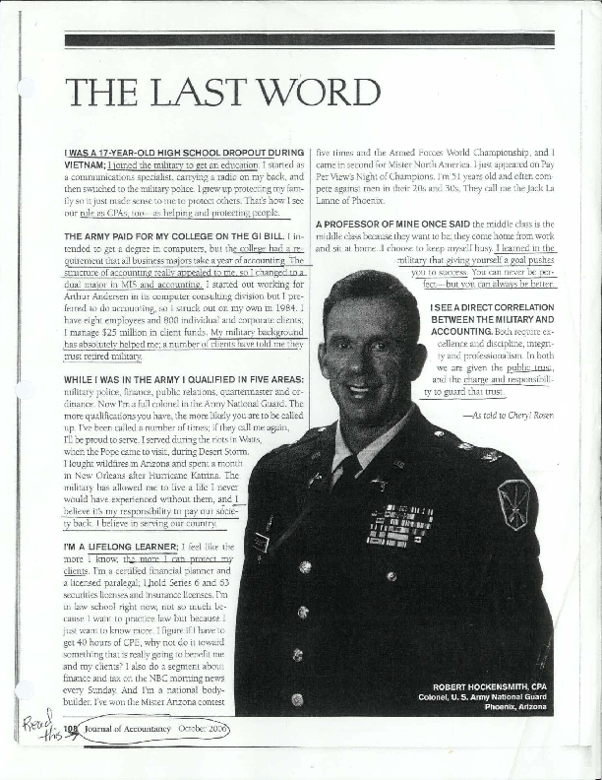
Serving the Public – analogous to military service

Slide 22
Professional Standards
Subchapter B states “The public accounting profession has a duty to follow generally accepted auditing standards, generally accepted accounting principles, or other applicable professional standards.
A certificate holder shall not permit his name to be associated with financial statements unless he has complied with GAAS.
A certificate holder shall not issue a report asserting that financial statements are in conformity with GAAP.
Must comply with other applicable standards.

Slide 23
Subchapter C – Responsibilities to Clients
In order to serve clients, a certificate holder must be independent in fact and appearance when performing engagements in which a report will be issued on financial statements.
Independence is impaired if certificate holder has:
  Any direct or material indirect financial interest in the client
  Any service as trustee or executor/administrator of estates/trusts
  Any investment or loans with client
  Any association with clients even by close relatives that would lead a reasonable person to conclude threat to objectivity/independence.

Slide 24
Receipt of Commissions or other compensation
If compensation is received for services or products, disclosed in writing.
Disclose regardless of amount.
Certificate holders shall not receive commissions when they perform services requiring independence.

Slide 25
Receipt of Contingency Fees
Certificate holder shall not perform any services for a contingent fee for services requiring independence.
Contingent fee is liable or probable to occur due to dependence of a future event.
Prohibits things such as:
  No tax return services for contingent fees
  no accounting expert services for contingent fees

Slide 26
Integrity and Objectivity
Certificate holder shall maintain integrity and objective, shall be free of conflicts of interest and shall not misrepresent facts now subordinate judgment to others.
Attest engagements requiring independence cannot be eliminated by disclosure
Cannot pay commissions for clients

Slide 27
Competence
Certificate holder shall not undertake any engagement for performance of services which he/she cannot reasonably expect to complete with due professional competence.
Competence includes technical qualifications and ability to supervise and evaluate work of others
Requires due professional care

Slide 28
Confidential Client Communications
Be discreet; keep client things confidential
Disclose only if pursuant to court proceedings, subpoenas or other compulsory services

Slide 29
Records and
Work Papers
Upon request, regardless of the status of the client’s account, a certificate holder shall provide records to the client used in performance of professional services.
Reasonable to charge for personnel time/ copying, etc.
Working papers developed during services are the property of the certificate holder

Slide 30
Subchapter D – Responsibilities to the Public
Responsibility “to serve the public interest” is all important.
Certificate holders must allow use of his/her name with a set of financial statements with clear lines of responsibility to investors and others.
Scandals have created a major expectations gap between what the public considers as an audited financial statement and what it actually gets.
Rules of Professional Conduct clearly states responsibilities.
Certificate holders have a duty to ensure “the public interest” in practice of public accountancy.

Slide 31
Practice of Public Accountancy
Certificate holders may not engage in the practice of public accountancy unless he/she holds a valid license issued by the board.
Must be in good standing with the Board
Must practice in an entity that is registered in Texas
Or state “not qualified to register with the Texas State Board of Public Accountancy to practice”

Slide 32
Advertising
Certificate holders shall not use any language that is false, fraudulent, misleading, or deceptive or that was obtained with coercion, duress, compulsion, intimidation, thread, overreaching, or vexatious conduct.
Violation to persist in contacting clients that do not desire to be contacted
Should keep mailings along with lists of persons to whom mailings were distributed for 36 months

Slide 33
Firm Names
A firm name may not include words relating to the quality of services offered or that is misleading about the legal form of the firm.
Firm name is misleading if
  it is not registered
  the name misrepresent facts
  the name indicated character or grade of service
  the name is likely to mislead or deceive
  the name implies special expertise
  the name implies professional attainment that is not factual
  the name does not include the words “corporation” or an appropriate abbreviation of such
  The name includes “and company “ or another similar connotation when there is only ONE PERSON
  The firm fails to contain the personal name of a partner or shareholder

Slide 34
Subchapter E – Responsibilities to the Board/Profession
Now in 2010m we have the U.S. Sentencing Guidelines and Sarbanes-Oxley Act that are intended to document consequences for adhering to good professional practices.
Subchapter E documents responsibilities for practitioners to the profession and to the Texas State Board of Public Accountancy.
Certificate holder or licensee has duty to be responsible to the profession while practicing public accountancy
Such tone in operations is essential for integrity of performance

Slide 35
Discreditable Acts
Certificate holders shall not commit any act that reflects adversely on fitness to engage in the practice of public accountancy.
Includes:
► Fraud
► Dishonesty
► Violation of any provisions of the Public Accountancy Act
► Conviction of a felony
► Conviction of any crime in connection with fraud in any state
► Revocation of suspension of any authority to practice public accountancy in any state
► Knowingly preparing false or misleading financial statements
► Breach of fiduciary responsibility of any type
► Failure to comply with orders of any state or court
► Repeated failure to respond to a client’s inquiry
► Perjury in any communication
► Threats of bodily harm or retribution
► Public allegations of lack of mental capacity not supported by facts
► Causing breach in security of the CPA examinations
Licensees shall report in writing to the TSBPA the occurrence of any event within 30 days in writing

Slide 36
Frivolous Complaints, Responses, and CPE
Certificate holders who accuse other certificate holders of violating the rules should be very factual.
Any request for communication from the Board requires a response within 30 days.
Continuing Professional Education (CPE) is mandatory.
120 clock hours of CPE every 3 years as stated in Section 523.63

Slide 37
The CPA’s Guide to Ethical Behavior in the 21st Century
  Sarbanes-Oxley (SOX)

Slide 38
The CPA’s Guide to Ethical Behavior
CPAs must follow SOX;
This means the integrated audit, which covers internal controls;
Internal Control Systems deal with control environments that can be as “fragile as eggs”;
Certificate holders should be aware of red flags and signals of fraudulent activity;
SAS 99 and AUC 240 (or SAS 122) says CPAs must look for fraud . . . brainstorm ways fraud could occur (when doing audits of public companies).

Slide 39
The CPA’s Guide to Ethical Behavior
Fraud costs all of us
Good employees can go bad and commit fraud
Virtue ethics is important
https://hbr.org/2011/06/wise-leadership

